Slide 1

CE101 Engineering Drawing Lec3: ORTHOGRAPHIC PROJECTIONS
Indian Institute of Technology Guwahati
Notes:
Today we will discuss about the Modeling and

Slide 2
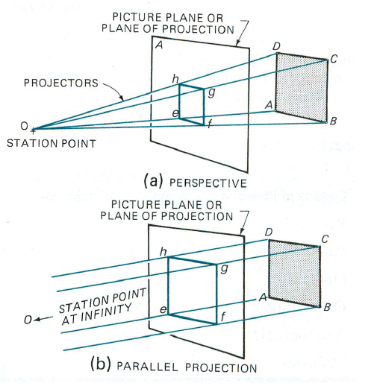
In engineering drawing, the word ‘projection’ means
an image or the act of obtaining the image of an object.
Technical people often refer to the image as a view.
This lecture reviews methods of projection and the important terms and the conventions associated with them.
Projection System
Observer or stationary point
Object
Projectors
Plane of projections (POP)

Slide 3
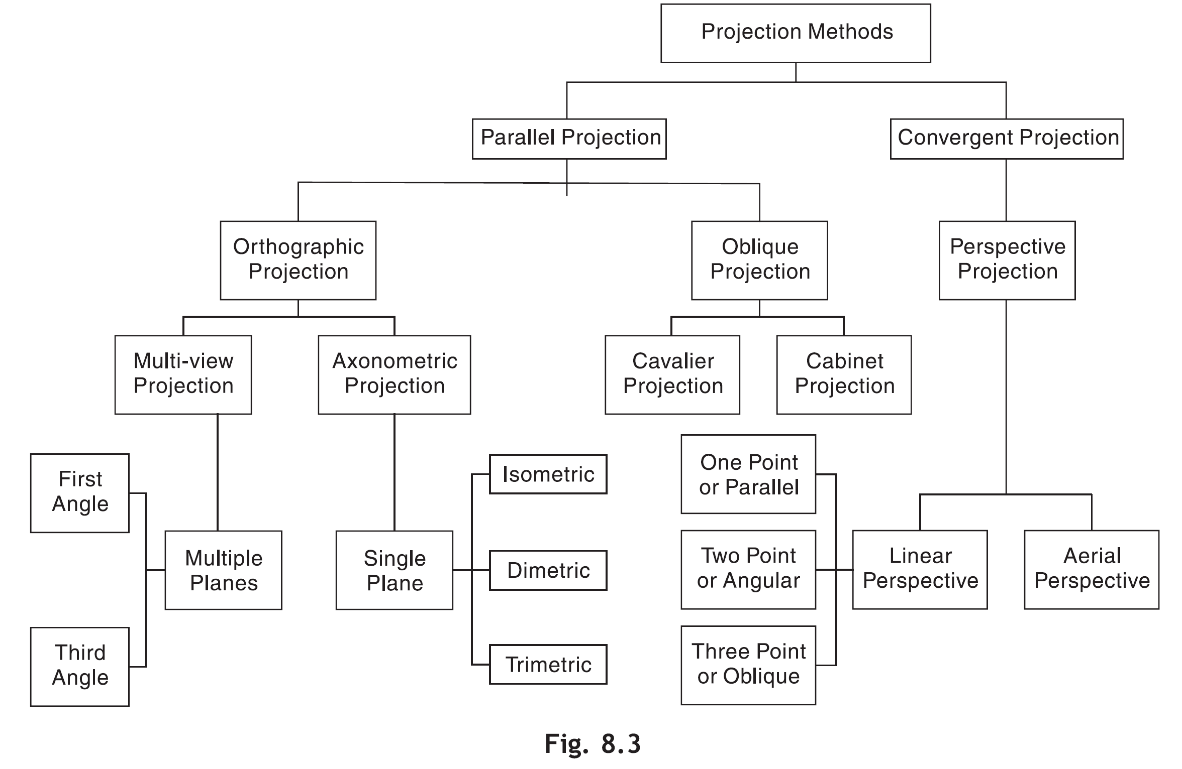
PROJECTION METHOD
Depending on the relationship between the projectors and POP and the number of POPs used for the projections, the projection methods are classified as shown in Fig.

Slide 4
Orthographic Projections
Orthographic Projections is a technical drawing in which different views of an object are projected on different reference planes observing perpendicular to respective reference plane.
Different Reference planes are;
Horizontal Plane (HP)
Vertical Plane (VP)
Side or Profile Plane (PP)
Different views are;
Front View (FV) – Projected on VP
Top View (TV) – Projected on HP
Side View (SV) – Projected on PP

Slide 5
Types of views
Projections
Parallel
Converge
Orthogonal
Oblique
Multiview
Axonometric
Multi-view drawing
Pictorial drawing
Perspective drawing

Slide 6
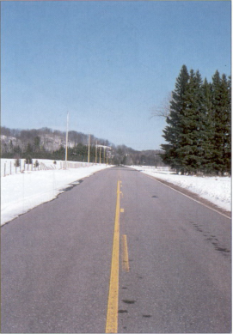
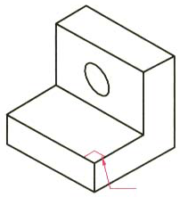
View comparison
Type
Advantage
Disadvantage
Multi-view drawing
Accurately presents object’s details, i.e.
size and shape.
Require training
to visualization.
Pictorial drawing
Easy to visualize.
Shape and angle distortion
Circular hole becomes ellipse
Right angle becomes obtuse angle.
Perspective drawing
Object looks more like what our eyes
perceive.
Difficult to create
Size and shape distortion
Distorted
width

Slide 7
PRINCIPAL PLANES
A POP is a plane on which a particular view is projected.
In multiview orthographic projections,
Different POPs are required to draw different views of an object.
Three such planes, perpendicular to each other, are called principal planes or reference planes (RP).
Types of RPs
Horizontal Plane: A plane parallel to the ground (or horizon) is called horizontal plane (HP) or horizontal reference plane (HRP).
Vertical Plane: A plane perpendicular to the ground and intersecting the HP is called vertical plane (VP) or frontal reference plane (FRP).
Profile Plane: A plane perpendicular to the HP and the VP and intersecting both of them is called profile plane (PP) or profile reference plane (PRP).

Slide 8
Front View When the observer looks at the object from the front, the view obtained is called the front view (FV) or Elevation. FV is seen on the VP.
Top View When the observer looks at the object from above, the view obtained is called top view (TV) or plan. TV is seen on the HP.
Side Views When the observer looks at the object from side, i.e., from his left-hand side or righthand side, the view obtained is called side view (SV). SV is seen on the PP.
Left-Hand Side View When the observer views the object from his left-hand side, the view obtained is called left-hand side view (LHSV).
Right Hand Side View When the observer views the object from his right-hand side, the view obtained is called as right-hand side view (RHSV).
Bottom View When the observer looks to the object from below, the view obtained is called bottom view (BV) or bottom plan.
Rear View When the observer looks to the object from back, the view obtained is called rear view (RV) or back view or rear elevation.
The FV, TV and either LHSV or RHSV are usually drawn in orthographic projection. The other views are added if they are extremely essential.

Slide 9

Projection systems
1. First angle system
- European countries - ISO standard
First
quadrant
2. Third angle system
- Canada, USA, Japan, Thailand
Transparent
planes
Opaque
planes
Third
quadrant

Slide 10

Orthographic views
1st angle system
(Opaque planes)
3rd angle system
(transparent planes/glass box)

Slide 11
Orthographic views
1st angle system
3rd angle system
Folding
line

Folding
line
Folding
line

Folding
line

Slide 12

Views arrangement
1st angle system
3rd angle system
Top View
Right Side View
Front View
Front View
Right Side View
Top View

Slide 13
Projection symbols
1st angle system
3rd angle system
d
1.7d
2.2d

Slide 14
PLANES
PRINCIPAL PLANES
HP AND VP
AUXILIARY PLANES
Auxiliary Vertical Plane
(A.V.P.)
Auxiliary Inclined Plane
(A.I.P.)
Profile Plane
( P.P.)

A.V.P.
A.I.P.
⊥ to Hp & ∠ to Vp
⊥ to Vp
&
∠ to Hp


Slide 15
PATTERN OF PLANES & VIEWS (First Angle Method)
THIS IS A PICTORIAL SET-UP OF ALL THREE PLANES.
ARROW DIRECTION IS A NORMAL WAY OF OBSERVING THE OBJECT.
BUT IN THIS DIRECTION ONLY VP AND A VIEW ON IT (FV) CAN BE SEEN.
THE OTHER PLANES AND VIEWS ON THOSE CAN NOT BE SEEN.
Y
PROCEDURE TO SOLVE ABOVE PROBLEM:-
TO MAKE THOSE PLANES ALSO VISIBLE FROM THE ARROW DIRECTION,
A) HP IS ROTATED 90⁰ DOUNWARD
B) PP, 90⁰ IN RIGHT SIDE DIRECTION.
THIS WAY BOTH PLANES ARE BROUGHT IN THE SAME PLANE CONTAINING VP.
X
Click to view Animation
On clicking the button if a warning comes please click YES to continue, this program is
safe for your pc.
Y
VP
PP
FV
LSV
X
Y
X
TV
HP
ACTUAL PATTERN OF PLANES & VIEWS
OF ORTHOGRAPHIC PROJECTIONS
DRAWN IN
FIRST ANGLE METHOD OF PROJECTIONS
HP IS ROTATED DOWNWARD 90⁰
AND
BROUGHT IN THE PLANE OF VP.
PP IS ROTATED IN RIGHT SIDE 90⁰
AND
BROUGHT IN THE PLANE OF VP.

Slide 16
NOTATIONS
Following notations should be followed while naming
Different views in orthographic projections.
OBJECT POINT A LINE AB
IT’S TOP VIEW a a b
IT’S FRONT VIEW a´ a´ b´
IT’S SIDE VIEW a´´ a´´ b´´
Same system of notations should be followed
incase numbers, like 1, 2, 3 – are used.
TERMS ‘ABOVE’ & ‘BELOW’ WITH RESPECT TO H.P.
AND TERMS ‘INFRONT’ & ‘BEHIND’ WITH RESPECT TO V.P.

Slide 17
Multi-view orthographic projections
In this type of projection, we imagine the object being drawn in the center of a transparent box.
The different views of the object are projected onto the sides of this box.

Slide 18
Multi-view orthographic projections
The projection box and its six views are spread in such a way as to place all the views on the same plane.
The other views pivot around the front view.
TOP VIEW
REAR VIEW
LEFT SIDE VIEW
FRONT VIEW
RIGHT SIDE VIEW
BOTTOM VIEW

Slide 19
Multi-view orthographic projections
Among the six possible views, we will choose to portray those necessary to the description of the shape of the object.
Three views are usually enough to portray an object. Many simple objects may only require one or two views.
TOP VIEW
REAR VIEW
LEFT SIDE VIEW
FRONT VIEW
RIGHT SIDE VIEW
BOTTOM VIEW

Slide 20
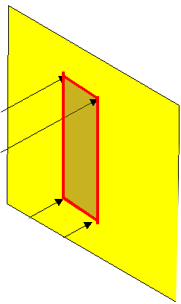
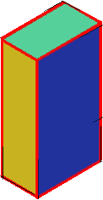
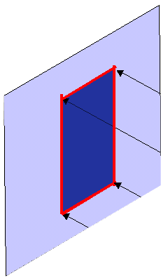
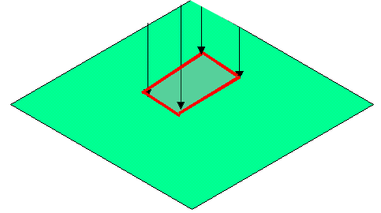
FIRST ANGLE
PROJECTION
FOR T.V.
IN THIS METHOD,
THE OBJECT IS ASSUMED TO BE
SITUATED IN FIRST QUADRANT
MEANS
ABOVE HP & INFRONT OF VP.
V.P.
P.P.
F.V.
S.V.
OBJECT IS INBETWEEN
OBSERVER & PLANE.
OBJECT
VP
PP
FV
LSV
X
Y
FOR S.V.
FOR F.V.
TV
HP
ACTUAL PATTERN OF
PLANES & VIEWS
IN
FIRST ANGLE METHOD
OF PROJECTIONS

Slide 21
THIRD ANGLE
PROJECTION
FOR T.V.
IN THIS METHOD,
THE OBJECT IS ASSUMED TO BE
SITUATED IN THIRD QUADRANT
( BELOW HP & BEHIND OF VP. )
PLANES BEING TRANSPERENT
AND INBETWEEN
OBSERVER & OBJECT.
P.P.
V.P.
OBJECT
TV
X
Y
S.V.
F.V.
LSV
FV
ACTUAL PATTERN OF
PLANES & VIEWS
OF
THIRD ANGLE PROJECTIONS
FOR S.V.
FOR F.V.

Slide 22
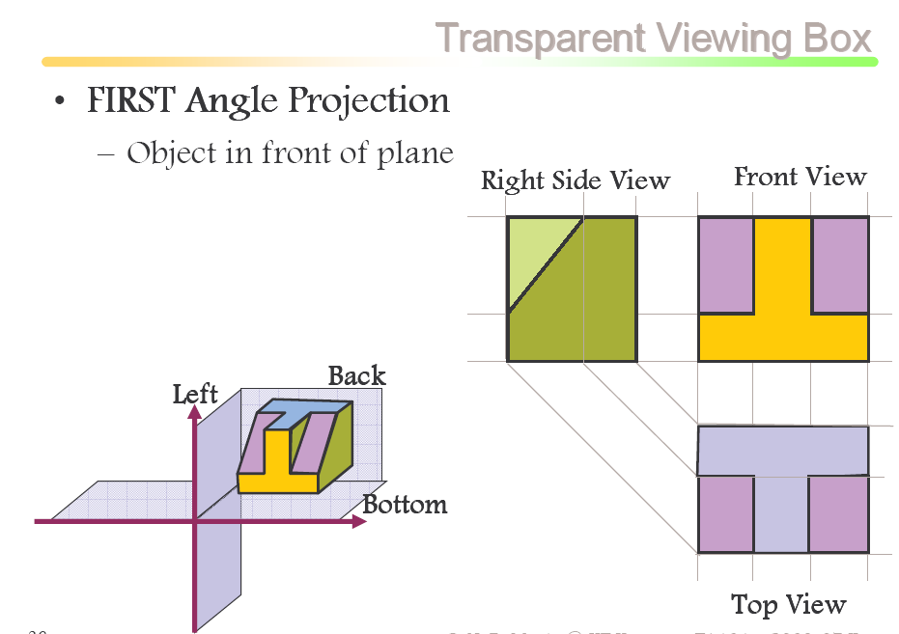
FV

Slide 23
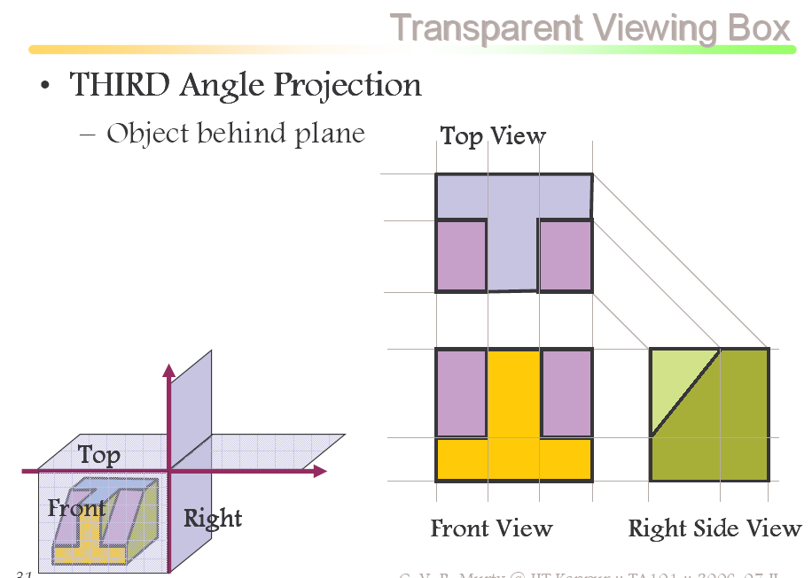

Slide 24
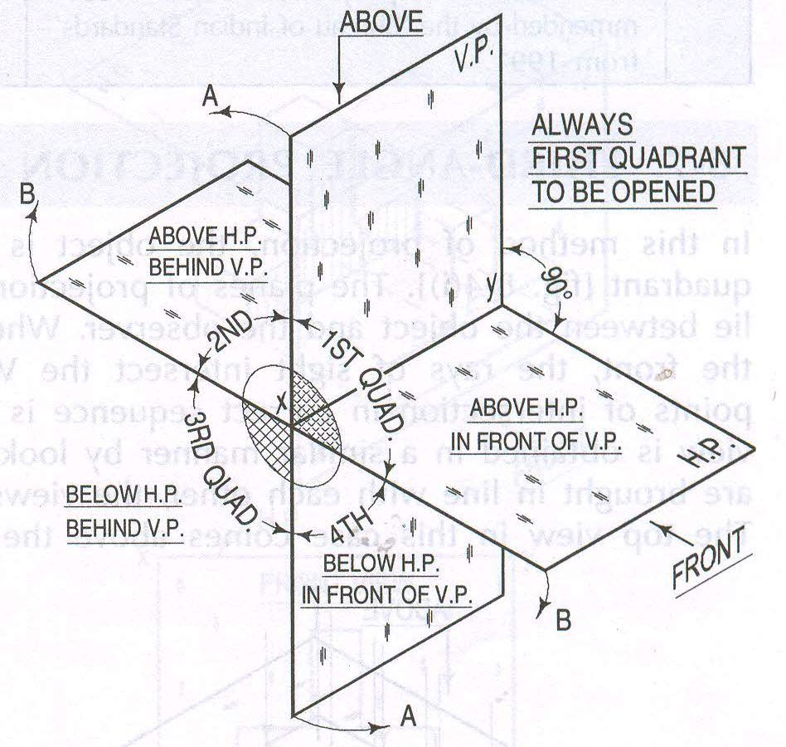

Slide 25
Example 1
Two dimensions are visible.
What is third dimension?
Another view is required.

Slide 26
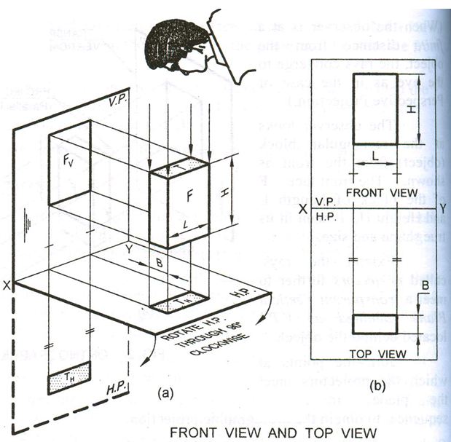

Slide 27
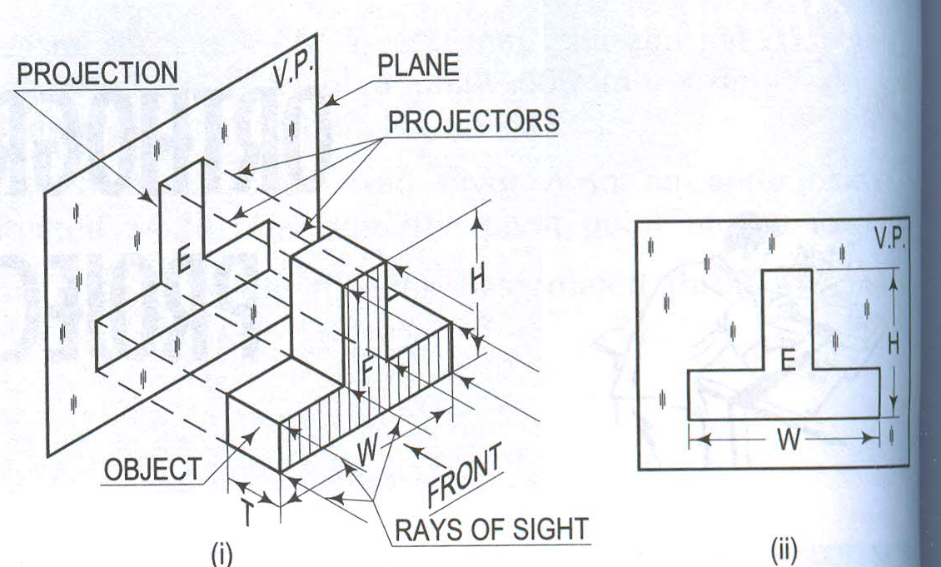
Example 2

Slide 28
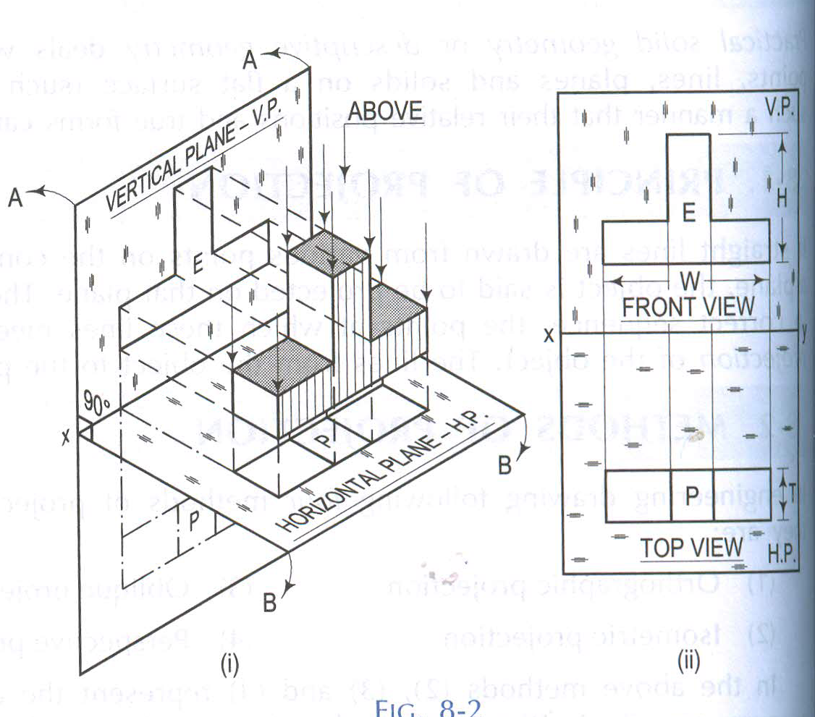

Slide 29
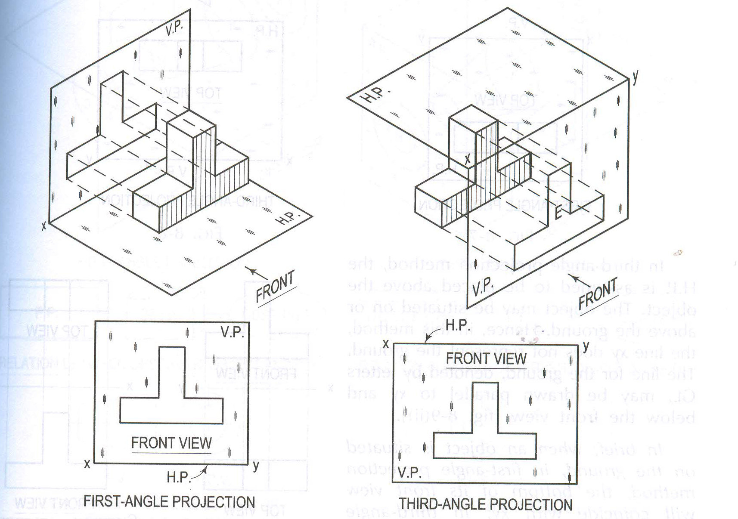
Example 2: Reference Line

Slide 30
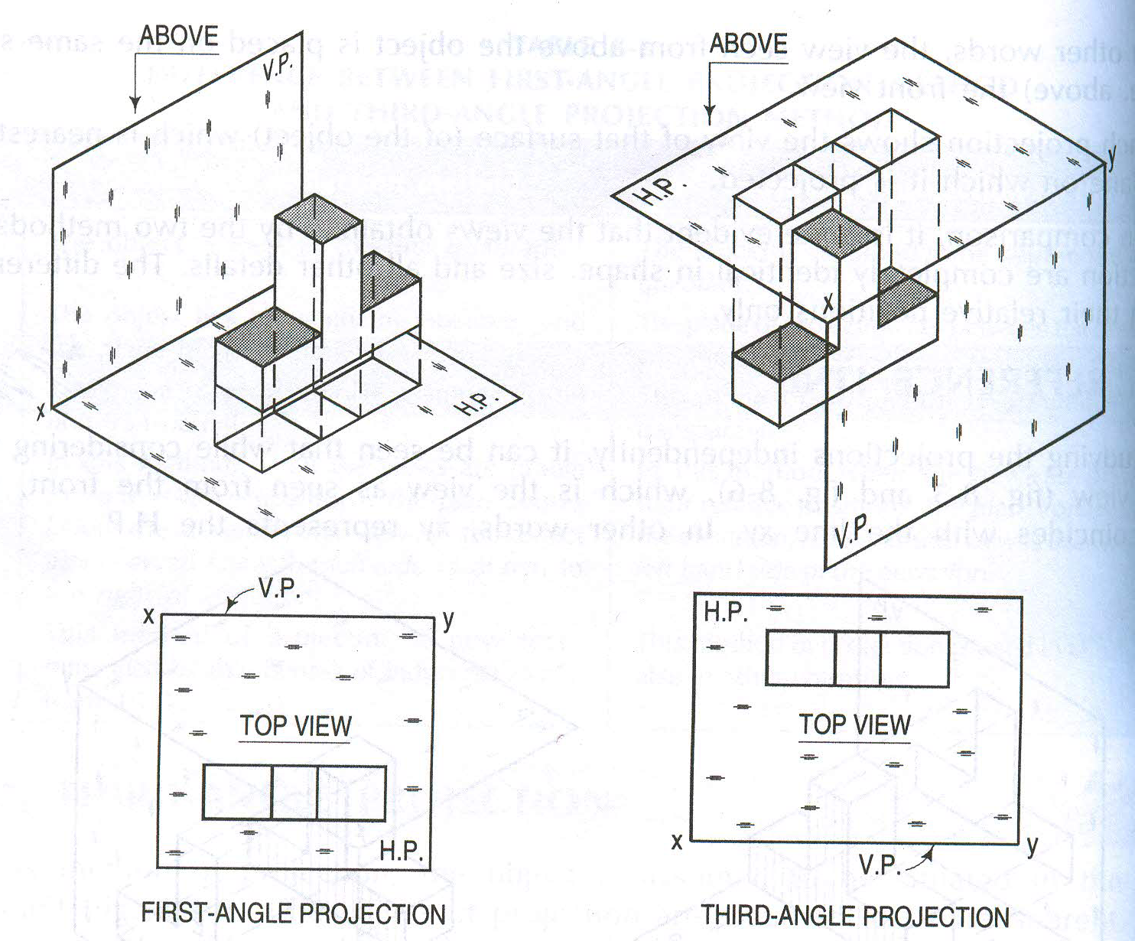
Example 2: Reference Line

Slide 31
To obtain the projections of various faces of an object, the following rules must be observed
If a face is perpendicular to the direction of viewing, its true shape and actual size will be seen in that view.
If a face is parallel to the direction of viewing, it is seen as a line in that view. This view is called the line view or edge view.
If a face is inclined to the direction of viewing, its true shape and size will not be seen in any view.
If an edge of the object is perpendicular to the direction of viewing, its actual length will be seen in that view.
If an edge of the object is parallel to the direction of viewing, it is seen as a point in that view. This view is called point view.
If an edge of the object is inclined to the direction of viewing, its shortened length (projected) will be seen in that view. The shortened length is obtained by locating the end points of the edge.

Slide 32
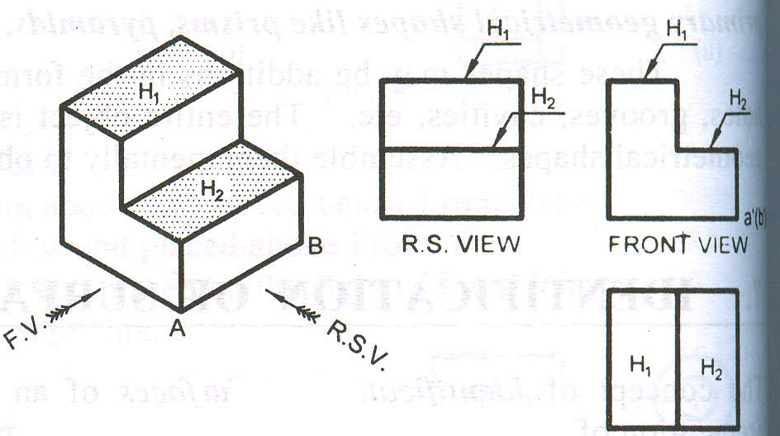
TV
TV
Parallel Surfaces

Slide 33
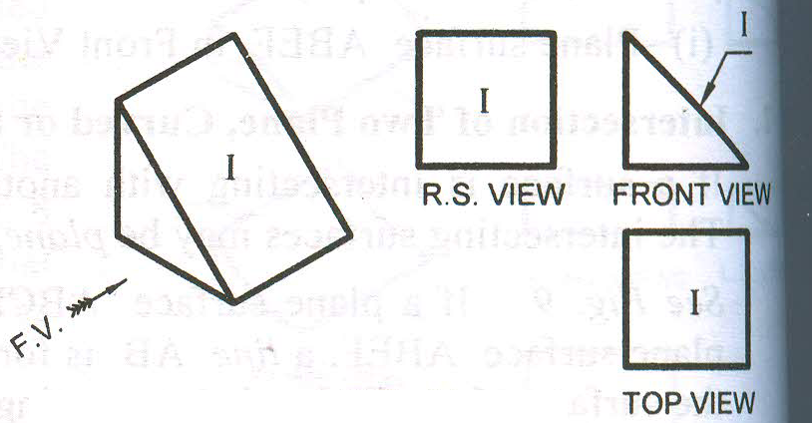
h
w
h
u
w
u
w
Inclined Surfaces

Slide 34
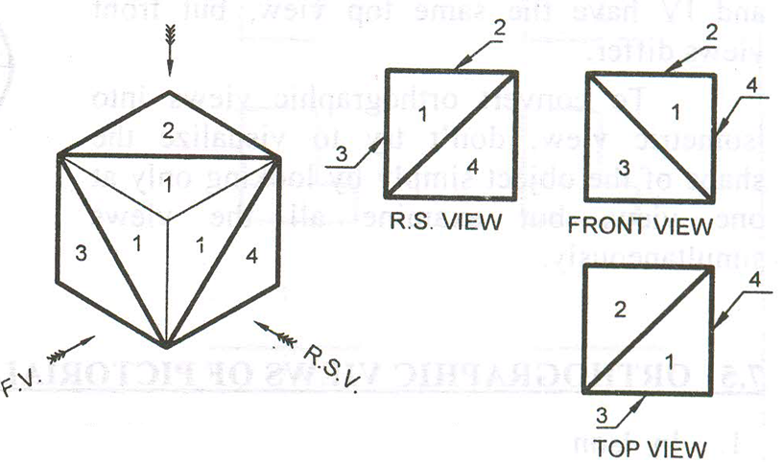
Oblique Surfaces

Slide 35
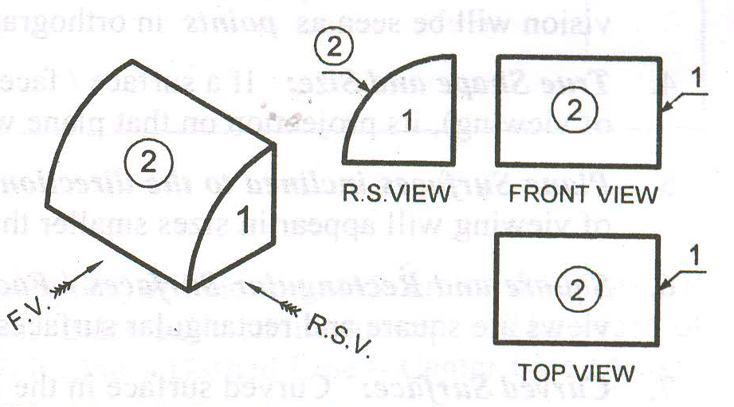
h
u
h
u
w
w
u
Curved Surfaces

Slide 36
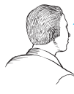
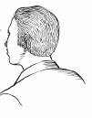
Methods of Orthogonal Projection
1. Natural Method: Revolve the object with respect to observer
2. Glass box method: The observer moves around the object.
Glass box concept
Top view
Top view
Front
view
Right side
view
Front view
Right side view
play
play

Slide 37
Glass box : Revolution of the planes of projection
Rear view
Left side view
Bottom view

Slide 38
Relative orientation of views
Top view
Depth
Front view
Width
Height
Rear view
Left side view
Right side view
Bottom view

Slide 39
Summary : Problem solving steps
Given
1
2
3
4

Slide 40


Steps for Orthographic Views
152
1. Select the necessary views
64
Top
25~40
2. Layout the selected views on a drawing sheet.
45
Front
152
Choose a drawing scale
(say 1:1)
3. Complete each selected views.
x
x
y
z
Top
4. Complete the
dimensions and notes.
y
x
x
Front
y
y

Slide 41
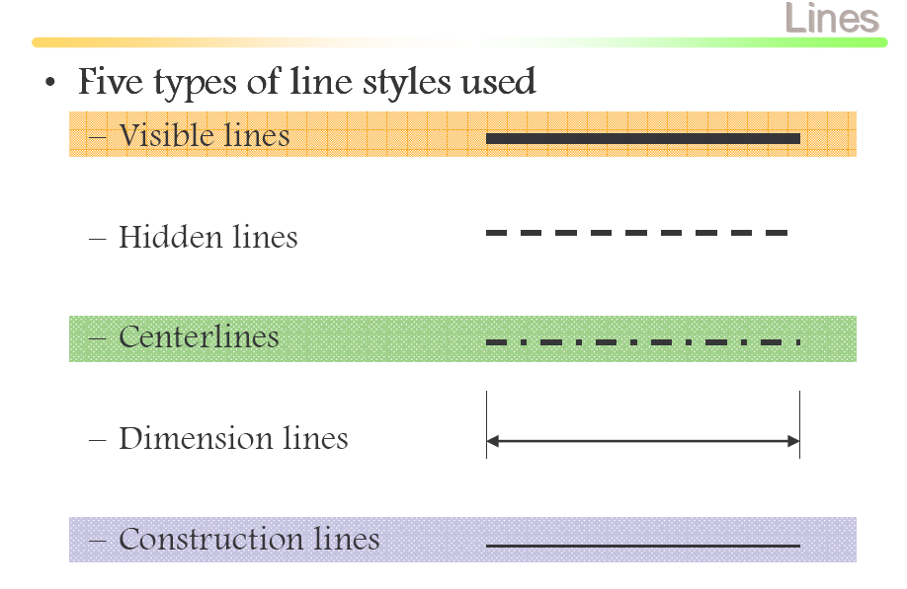

Slide 42
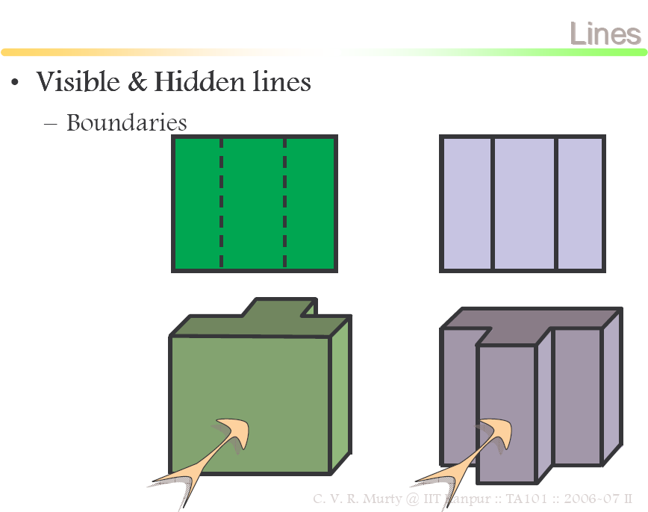

Slide 43
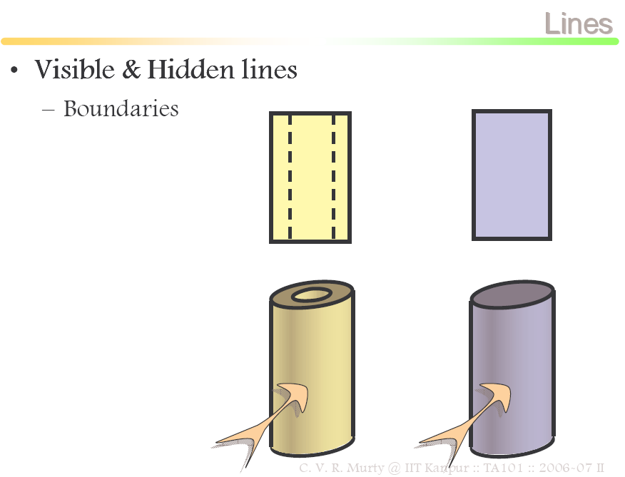

Slide 44
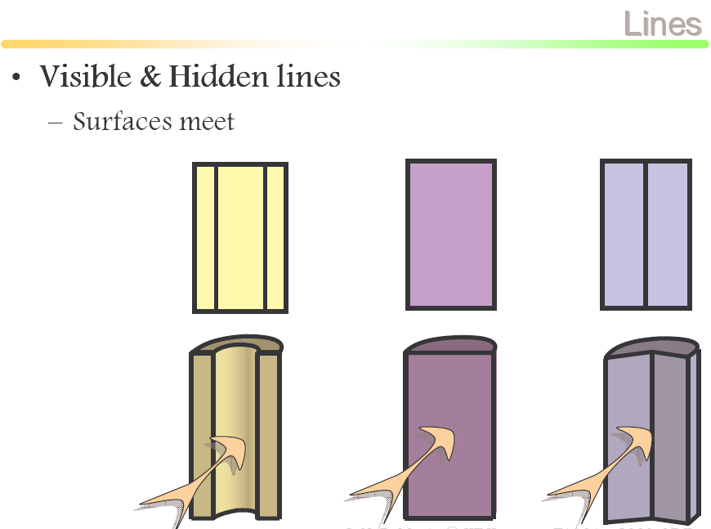

Slide 45
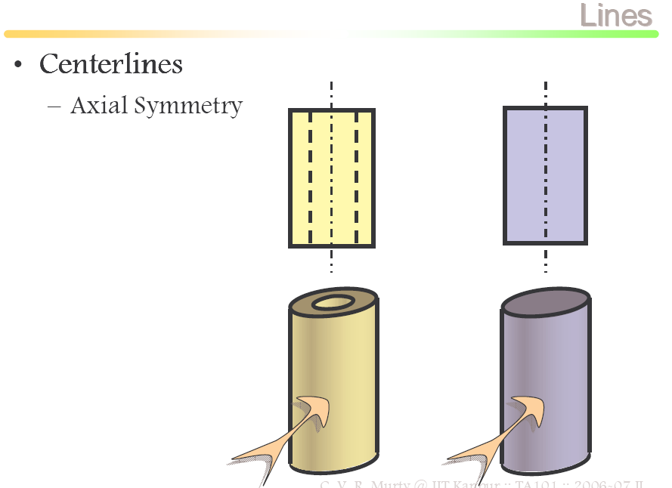

Slide 46
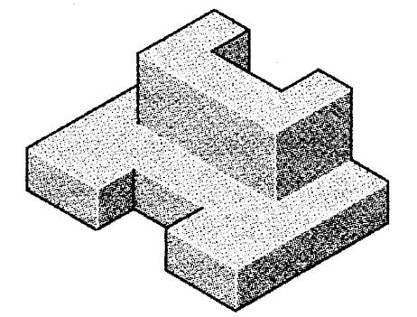
Construction Lines
Construction lines are used to transfer depth information.
45º line drawn from point O
O
Standard multiviews

Slide 47
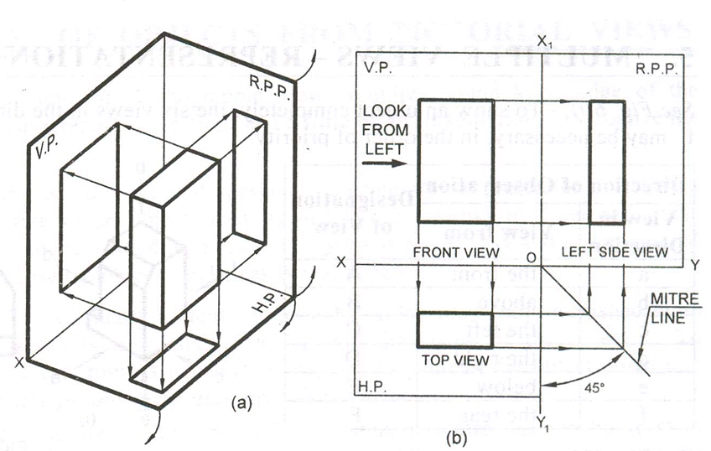
Projecting Side Views
Projecting across meter line
Projecting through arcs
Projecting through 45º projectors

Slide 48
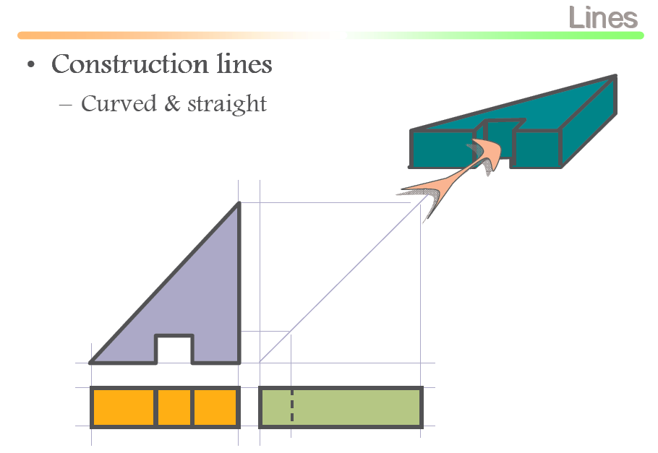
TV
FV
LSV

Slide 49
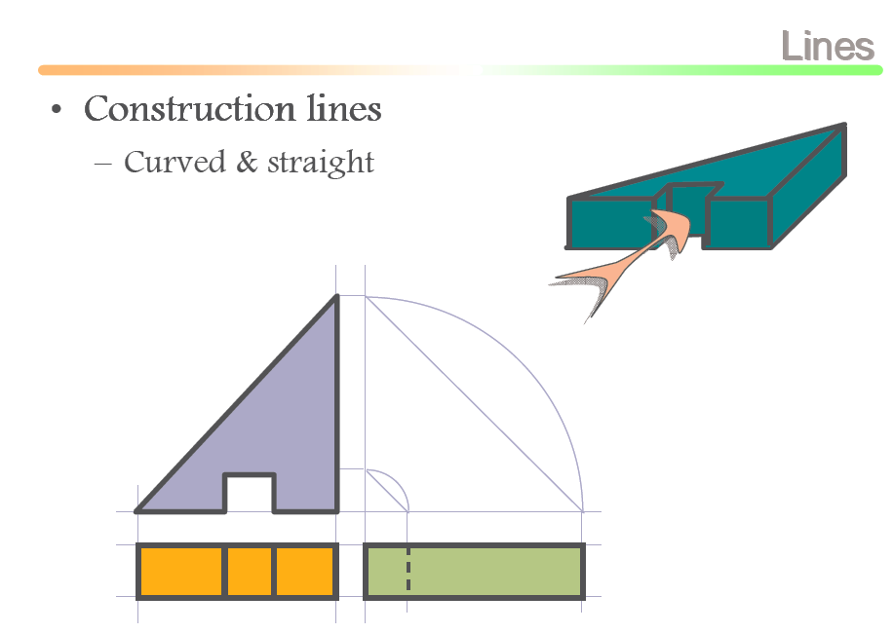

Slide 50
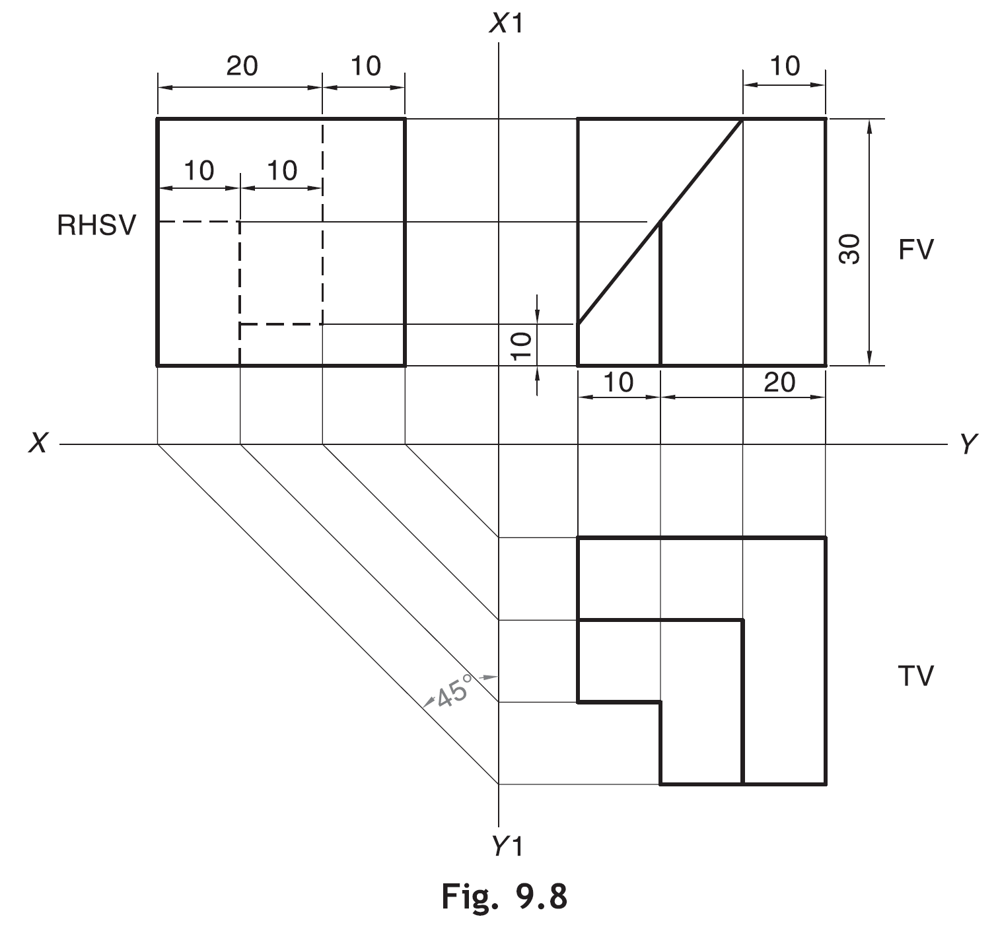
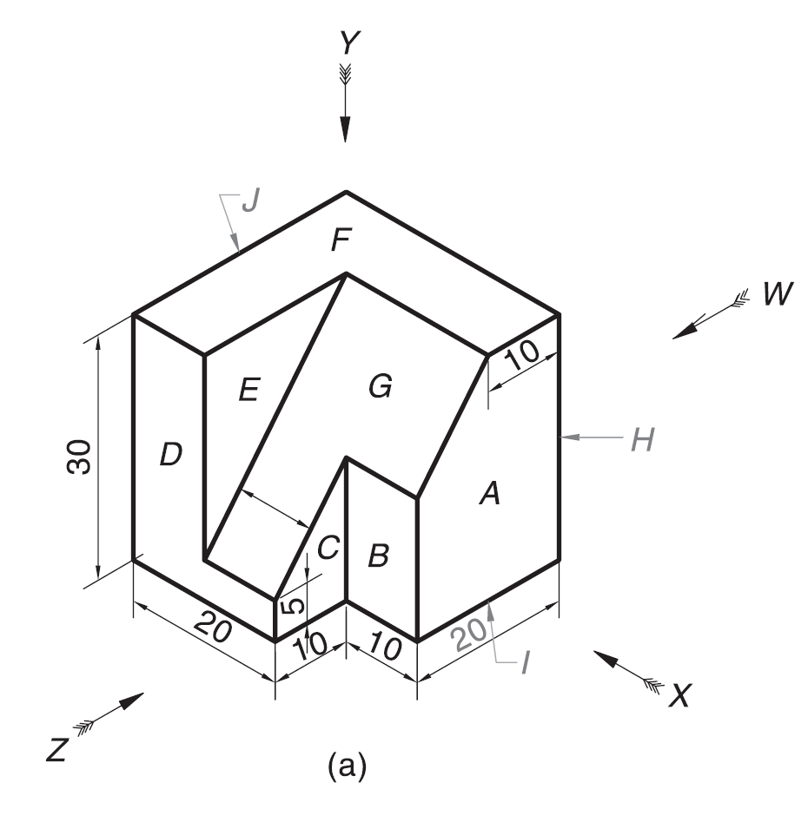
Hidden Features:
The features of the object not seen in a particular view are called as hidden features. The hidden features, internal or external, are shown by drawing dashed lines for the edges (or extreme generators in case of cylindrical or conical features) forming the hidden feature in that particular view.
Draw the RHSV of the object It is clear that, in RHSV (i.e., the view in the direction W) the faces B, G and D will not be seen. As these are hidden features, they are shown by dashed lines

Slide 51
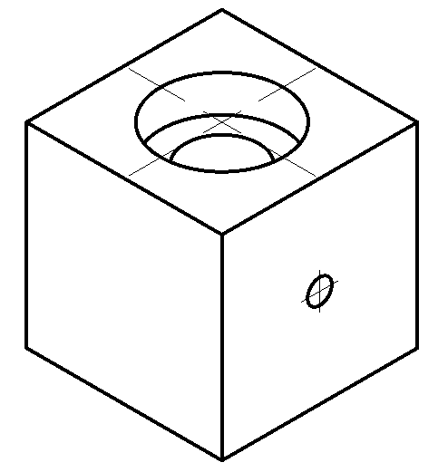
Example
1. Visible
2. Hidden
3. Center

Slide 52
View selection procedures
1. Orient the object to the best position relative to a glass box.
2. Select the front view.
3. Select adjacent views.

Slide 53
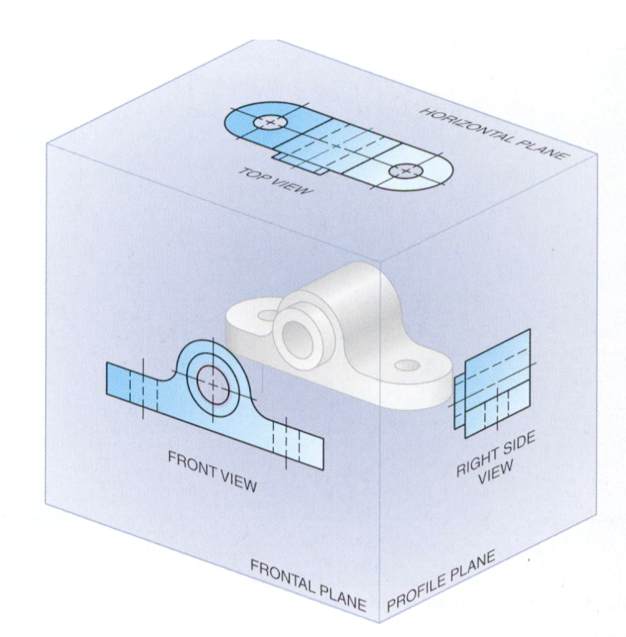
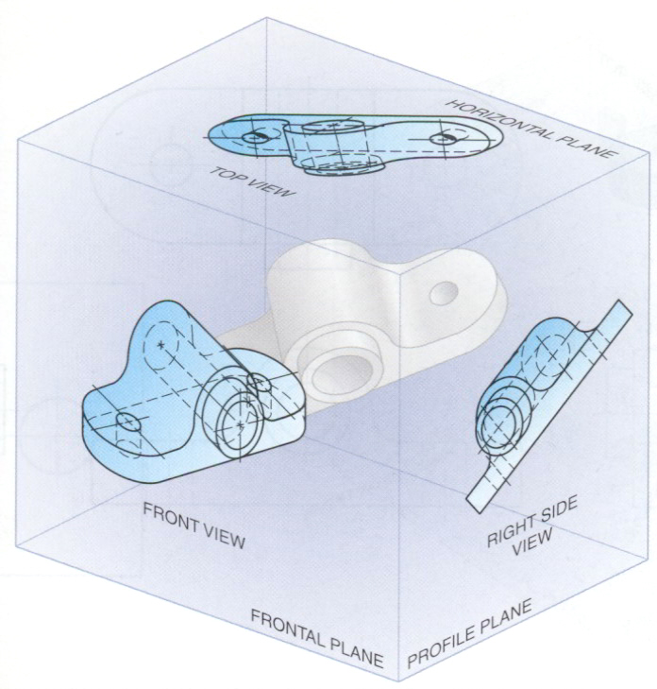
Suggestions: Orient the object
1. The object should be placed in its natural position.
2. The orthographic views should represent the true size and true shape of an object (as much as possible).
GOOD
NO !

Slide 54
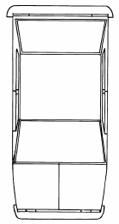
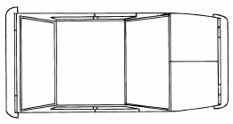
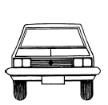
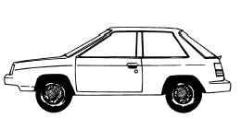
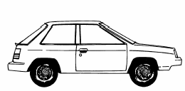

Suggestions: Select the front view
1. The longest dimension of an object should be presented as a width (in a front view).
First choice
Inappropriate
Second choice
Good
Use more space

Slide 55
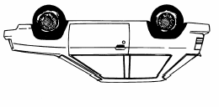
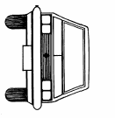
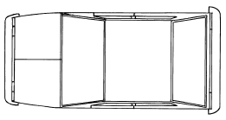
Suggestions: Select the front view
2. The adjacent views project from the selected front view should be appeared in a natural position.
Inappropriate

Slide 56

Suggestions: Select the front view
3. It has the fewest number of hidden lines.
Good
Inappropriate

Slide 57
Suggestions: Select an adjacent view
1. Choose the view that has the fewest number of hidden lines.
Inappropriate
Inappropriate

Slide 58
Suggestions: Select an adjacent view
2. Choose the minimum number of views that can represent the major features of the object.
All information is placed
on a single view.
Necessary
Hole’s information is placed on a separated view.
Necessary

Slide 59
Suggestions: Select an adjacent view
3. Choose the views that are suitable to a drawing sheet.
Poor
Not enough space
for dimensioning.
Choose another adjacent view.
Good
Change orientation of the
selected views.
Good

Slide 60
Summary
View selection has 3 steps
Orient
the object
Select
front view
Select
adjacent views

Slide 61
Object that requires only one-view
Flat (thin) part having a uniform thickness such as a gasket, sheet metal etc.
Cylindrical-shaped part.
Example
1 Thick
Adjacent views provide only a
part’s thickness !

Slide 62
Object that requires only one-view
Flat (thin) part having a uniform thickness such as a gasket, sheet metal etc.
Cylindrical-shaped part.
Example
Example
Repeat !
Infer from CL

Slide 63
Object that requires only two-view
Identical adjacent view exists.
The 3rd view has no significant contours of the object.
(provides no additional information)
Example
Repeat !

Slide 64
Object that requires only two-view
Identical view exists.
The 3rd view has no significant contours of the object.
(provides no additional information)
Example 1

Slide 65
Object that requires only two-view
Identical view exists.
The 3rd view has no significant contours of the object.
(provides no additional information)
Example 2

Slide 66
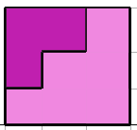
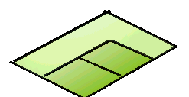
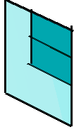
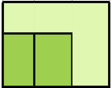

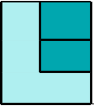

FOR T.V.
S.V.
F.V.
Example-2
ORTHOGRAPHIC PROJECTIONS
FRONT VIEW
L.H.SIDE VIEW
FOR F.V.
FOR S.V.
x
y
PICTORIAL PRESENTATION IS GIVEN
DRAW THREE VIEWS OF THIS OBJECT
BY FIRST ANGLE PROJECTION METHOD
TOP VIEW

Slide 67
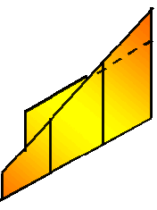






FOR T.V.
Example-3
S.V.
F.V.
ORTHOGRAPHIC PROJECTIONS
FRONT VIEW
L.H.SIDE VIEW
X
Y
FOR S.V.
FOR F.V.
TOP VIEW
PICTORIAL PRESENTATION IS GIVEN
DRAW THREE VIEWS OF THIS OBJECT
BY FIRST ANGLE PROJECTION METHOD

Slide 68







FOR T.V.
Example-4
F.V.
S.V.
ORTHOGRAPHIC PROJECTIONS
FRONT VIEW
L.H.SIDE VIEW
FOR S.V.
FOR F.V.
X
Y
PICTORIAL PRESENTATION IS GIVEN
DRAW THREE VIEWS OF THIS OBJECT
BY FIRST ANGLE PROJECTION METHOD
TOP VIEW

Slide 69







FOR T.V.
Example-5
S.V.
F.V.
ORTHOGRAPHIC PROJECTIONS
FRONT VIEW
L.H.SIDE VIEW
FOR F.V.
FOR S.V.
X
Y
PICTORIAL PRESENTATION IS GIVEN
DRAW THREE VIEWS OF THIS OBJECT
BY FIRST ANGLE PROJECTION METHOD
TOP VIEW

Slide 70







Example-6
FOR T.V.
F.V.
S.V.
ORTHOGRAPHIC PROJECTIONS
FRONT VIEW
L.H.SIDE VIEW
X
Y
FOR S.V.
FOR F.V.
TOP VIEW
PICTORIAL PRESENTATION IS GIVEN
DRAW THREE VIEWS OF THIS OBJECT
BY FIRST ANGLE PROJECTION METHOD

Slide 71
Example-7
FOR T.V.
ORTHOGRAPHIC PROJECTIONS
35
FV
35
x
10
y
10
20
30
FOR F.V.
40
70
TV
O
PICTORIAL PRESENTATION IS GIVEN
DRAW FV AND TV OF THIS OBJECT
BY FIRST ANGLE PROJECTION METHOD

Slide 72
Example-8
14
FOR T.V.
ORTHOGRAPHIC PROJECTIONS
FV
30
10
30
SV
30
10
30
x
y
FOR S.V.
FOR F.V.
TV
ALL VIEWS IDENTICAL
PICTORIAL PRESENTATION IS GIVEN
DRAW THREE VIEWS OF THIS OBJECT
BY FIRST ANGLE PROJECTION METHOD

Slide 73
Example-9
15
ORTHOGRAPHIC PROJECTIONS
FOR T.V.
ALL VIEWS IDENTICAL
FV
SV
x
y
10
40
60
FOR S.V.
FOR F.V.
40
TV
60
PICTORIAL PRESENTATION IS GIVEN
DRAW THREE VIEWS OF THIS OBJECT
BY FIRST ANGLE PROJECTION METHOD

Slide 74
FOR T.V.
Example-10
ORTHOGRAPHIC PROJECTIONS
ALL VIEWS IDENTICAL
FV
SV
x
y
10
FOR S.V.
FOR F.V.
40
60
PICTORIAL PRESENTATION IS GIVEN
DRAW THREE VIEWS OF THIS OBJECT
BY FIRST ANGLE PROJECTION METHOD
40
TOP VIEW
60

Slide 75
PICTORIAL PRESENTATION IS GIVEN
DRAW FV AND TV OF THIS OBJECT
BY FIRST ANGLE PROJECTION METHOD
ORTHOGRAPHIC PROJECTIONS
FOR T.V.
30
Example-11
FV
RECT.
SLOT
10
50
35
10
Y
X
20 D
FOR F.V.
TV
60 D
30 D
TOP VIEW
O

Slide 76
FOR T.V.
Example-12
ORTHOGRAPHIC PROJECTIONS
45⁰
30
FV
40
X
Y
30 D
FOR F.V.
40
TV
O
PICTORIAL PRESENTATION IS GIVEN
DRAW FV AND TV OF THIS OBJECT
BY FIRST ANGLE PROJECTION METHOD
15
40

Slide 77
Example-13
ORTHOGRAPHIC PROJECTIONS
10
10
15
25
25
X
Y
O
50
10
FV
LSV
FOR S.V.
FOR F.V.
PICTORIAL PRESENTATION IS GIVEN
DRAW FV AND LSV OF THIS OBJECT
BY FIRST ANGLE PROJECTION METHOD

Slide 78

FOR T.V.
Example-14
ORTHOGRAPHIC PROJECTIONS
FRONT VIEW
L.H.SIDE VIEW
X
Y
FOR F.V.
FOR S.V.
TOP VIEW
PICTORIAL PRESENTATION IS GIVEN
DRAW THREE VIEWS OF THIS OBJECT
BY FIRST ANGLE PROJECTION METHOD

Slide 79
ORTHOGRAPHIC PROJECTIONS
FRONT VIEW
L.H.SIDE VIEW
30 SQUARE
40
20
50
FOR F.V.
20
FOR S.V.
X
10
Y
O
30
F.V.
60
S.V.
PICTORIAL PRESENTATION IS GIVEN
DRAW FV AND SV OF THIS OBJECT
BY FIRST ANGLE PROJECTION METHOD

Slide 80
FOR T.V.
ORTHOGRAPHIC PROJECTIONS
FV
40
X
10
Y
O
30 D
45
FOR F.V.
O
10
50
PICTORIAL PRESENTATION IS GIVEN
DRAW FV AND TV OF THIS OBJECT
BY FIRST ANGLE PROJECTION METHOD
80
TV

Slide 81


Slide 82

Thank You for Patient Hearing

